Slide 1
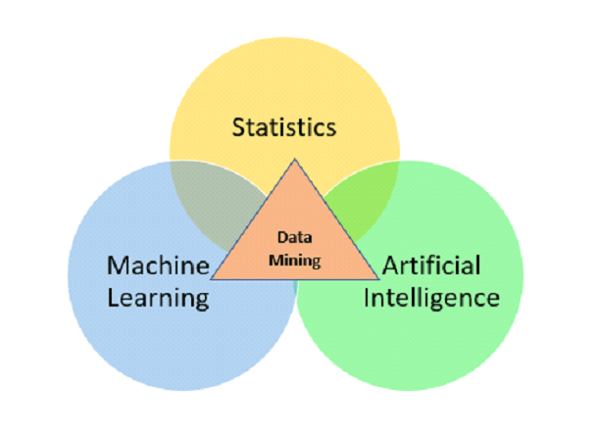
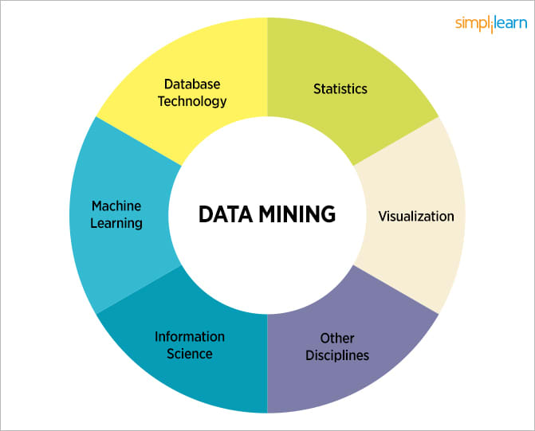
Data Mining

Slide 2
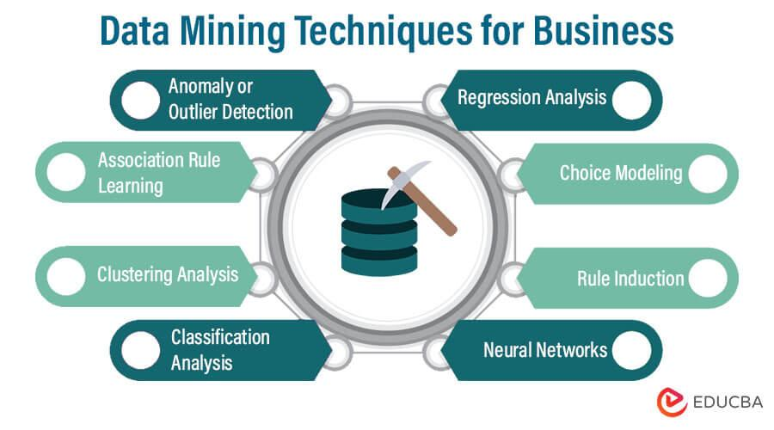
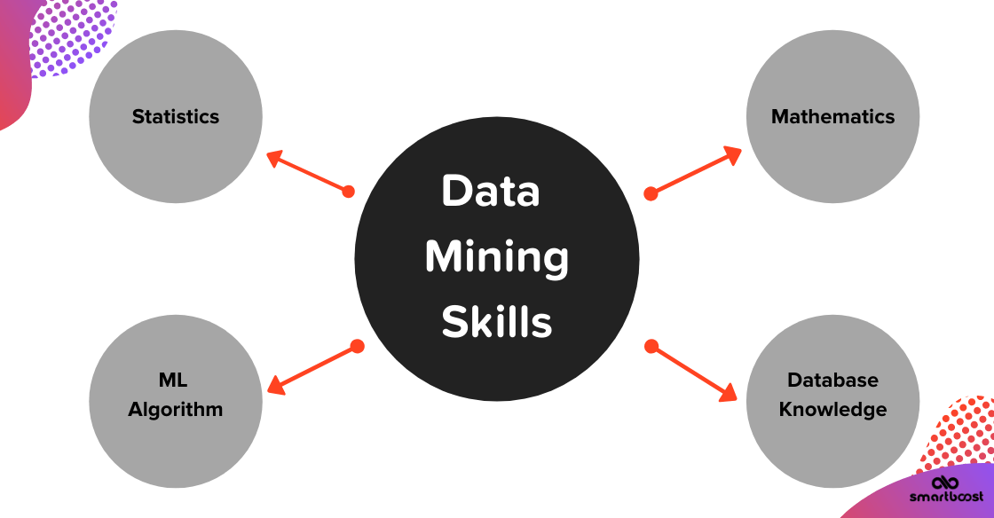
Basics of Data Mining
Data mining is the process of discovering patterns, relationships, and insights from large and complex datasets. It involves using various techniques, algorithms, and tools to extract meaningful and actionable information from data. The goal of data mining is to uncover hidden patterns, trends, correlations, and knowledge that can be used for decision-making, prediction, and optimization.

Slide 3
Basics of Data Mining
Types of Data Mining
Classification: Classification involves categorizing data into predefined classes or categories based on their attributes. It's used for tasks such as email spam detection, customer segmentation, disease diagnosis, and credit risk assessment.
Clustering: Clustering aims to group similar data points together based on their intrinsic characteristics, without predefined categories. It's used for market segmentation, social network analysis, and image segmentation.
Association Rule Mining: Association rule mining identifies relationships and patterns between different items in a dataset. It's often used in retail for market basket analysis, where associations between purchased products are discovered.
Anomaly Detection: Anomaly detection focuses on identifying data points that deviate significantly from the norm. It's used for fraud detection, network intrusion detection, and identifying defects in manufacturing.
Regression Analysis: Regression analysis predicts a continuous numeric value based on input variables. It's used for tasks like sales forecasting, demand prediction, and estimating the impact of variables on an outcome.

Slide 4
Basics of Data Mining
Types of Data Mining
Text Mining: Text mining involves extracting insights and information from textual data. It's used for sentiment analysis, document categorization, topic modeling, and summarization.
Time Series Analysis: Time series analysis deals with data collected over time to identify patterns and trends. It's used in financial forecasting, stock market analysis, and weather prediction.
Sequential Pattern Mining: Sequential pattern mining focuses on discovering sequences of events or items in data. It's used in areas like analyzing customer purchase sequences, web clickstreams, and DNA sequence analysis.
Spatial Data Mining: Spatial data mining analyzes geographic and spatial data to uncover patterns. It's used in urban planning, ecological modeling, and location-based services.
Web Mining: Web mining extracts knowledge from web-related data, including web pages, user behavior, and online transactions. It's used for tasks like web content categorization, user profiling, and recommendation systems.
Multimedia Mining: Multimedia mining deals with data such as images, audio, and video. It's used for image recognition, video analysis, and audio classification.
Social Network Analysis: Social network analysis studies relationships and interactions within social networks to understand influence, connectivity, and community structures.

Slide 5
Basics of Data Mining
Most frequently used Data Mining
Web Mining
Text Mining
Spatial Data Mining
Temporal
Image processing

Slide 6
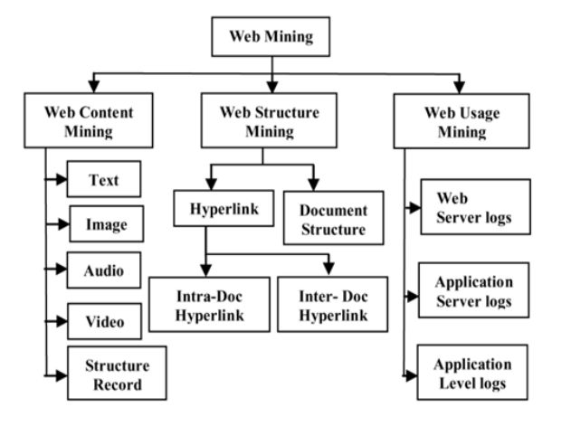
Web Mining
Web mining refers to the process of extracting valuable information and knowledge from web-related data, including web pages, social media content, user behavior, and online transactions. It involves using data mining techniques to analyze and uncover patterns, trends, and insights from the vast amount of data available on the internet.
There are three main types of web mining:
Web Content Mining: Involves extracting information from web pages, documents, and textual content. This includes tasks like web page categorization, sentiment analysis, and information retrieval.
Web Structure Mining: Focuses on analyzing the link structure of the web, including hyperlinks between web pages. It helps uncover relationships between web pages and can be used for tasks like identifying influential web pages and building recommendation systems.
Web Usage Mining: Involves analyzing user interactions and behaviors on the web, such as clickstreams, navigation patterns, and session data. It's used for tasks like user profiling, personalization, and improving website usability.

Slide 7
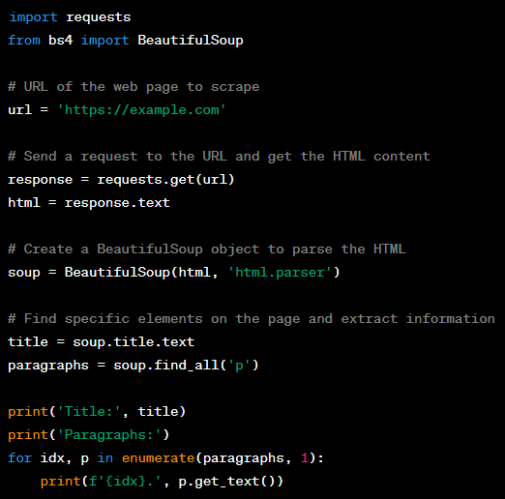
Web Mining
Here's a simple example of web content mining using Python and the BeautifulSoup library to extract information from a web page:
import requests
from bs4 import BeautifulSoup
# URL of the web page to scrape
url = 'https://example.com'
# Send a request to the URL and get the HTML content
response = requests.get(url)
html = response.text
# Create a BeautifulSoup object to parse the HTML
soup = BeautifulSoup(html, 'html.parser')
# Find specific elements on the page and extract information
title = soup.title.text
paragraphs = soup.find_all('p')
print('Title:', title)
print('Paragraphs:')
for idx, p in enumerate(paragraphs, 1):
print(f'{idx}.', p.get_text())

Slide 8
Text Mining
Text mining, also known as text data mining or text analytics, is the process of extracting valuable insights and knowledge from large volumes of textual data. It involves applying various natural language processing (NLP) and machine learning techniques to analyze, transform, and interpret unstructured text data to uncover patterns, trends, sentiments, and other useful information.
Examples of text mining applications include:
Sentiment Analysis: Determining the sentiment or emotional tone expressed in a piece of text, such as identifying positive, negative, or neutral sentiments in customer reviews or social media posts.
Topic Modeling: Identifying topics or themes present in a collection of documents. This is useful for organizing and summarizing large amounts of text data.
Text Classification: Categorizing text documents into predefined classes or categories. For instance, classifying news articles into topics like politics, sports, or entertainment.
Named Entity Recognition: Identifying and classifying named entities (e.g., names of people, organizations, locations) in text.
Text Summarization: Generating concise and coherent summaries of longer texts, such as news articles or research papers.
Information Extraction: Extracting specific pieces of structured information from unstructured text, such as extracting dates, prices, or other relevant data.
Text Clustering: Grouping similar text documents together based on their content.

Slide 9
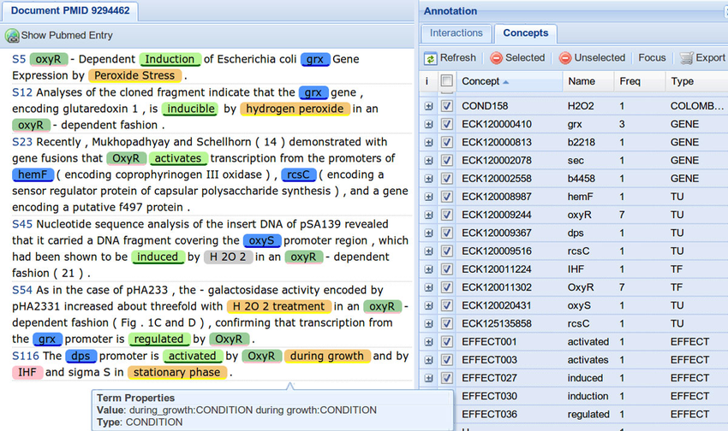
Text Mining
import nltk
from nltk.sentiment import SentimentIntensityAnalyzer
# Sample text
text = "I absolutely loved the movie! The acting was amazing and the plot was engaging."
# Initialize the sentiment intensity analyzer
sia = SentimentIntensityAnalyzer()
# Analyze sentiment
sentiment_scores = sia.polarity_scores(text)
# Determine sentiment based on the polarity score
if sentiment_scores['compound'] >= 0.05:
sentiment = 'Positive'
elif sentiment_scores['compound'] <= -0.05:
sentiment = 'Negative'
else:
sentiment = 'Neutral'
print("Text:", text)
print("Sentiment:", sentiment)
print("Sentiment Scores:", sentiment_scores)

Slide 10
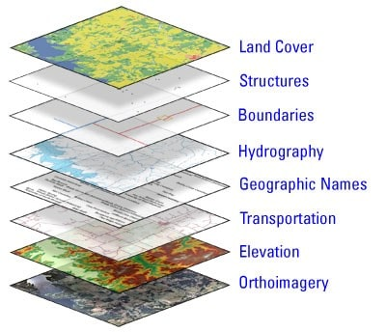
Spatial Data Mining
Spatial data mining is a subset of data mining that focuses on extracting patterns, relationships, and insights from spatial or geographic data. It involves applying data mining techniques to spatial datasets to uncover hidden information, trends, and patterns that can be useful for various applications in fields like geography, environmental science, urban planning, and more.
Examples of spatial data mining applications include:
Geographic Clustering: Identifying clusters of similar geographic locations based on certain attributes, such as clustering similar types of vegetation areas in remote sensing data.
Spatial Association Analysis: Discovering relationships between spatial entities, such as identifying co-occurring features in a map, like specific types of businesses that tend to be located together.
Location-Based Recommendation: Recommending points of interest or services to users based on their geographical location and preferences.
Spatial Outlier Detection: Identifying unusual or anomalous patterns in spatial data, like detecting areas with unusually high pollution levels.
Spatial Regression: Analyzing the relationship between spatial variables and a dependent variable, such as studying how various factors contribute to property prices in different neighborhoods.

Slide 11
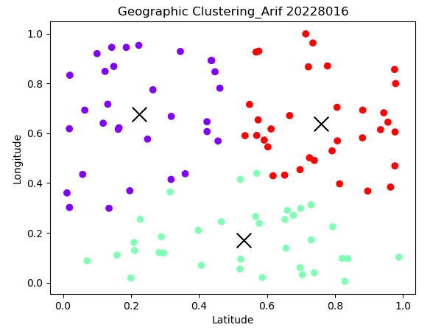
Spatial Data Mining
import numpy as np
from sklearn.cluster import KMeans
import matplotlib.pyplot as plt
# Generate random spatial data (latitude, longitude)
np.random.seed(0)
n_samples = 100
data = np.random.rand(n_samples, 2)
# Perform K-means clustering
n_clusters = 3
kmeans = KMeans(n_clusters=n_clusters)
kmeans.fit(data)
# Plot the data points and cluster centers
plt.scatter(data[:, 0], data[:, 1], c=kmeans.labels_, cmap='rainbow')
plt.scatter(kmeans.cluster_centers_[:, 0], kmeans.cluster_centers_[:, 1], marker='x', s=200, color='black')
plt.xlabel('Latitude')
plt.ylabel('Longitude')
plt.title('Geographic Clustering')
plt.show()

Slide 12
Temporal Data Mining
Temporal data mining involves analyzing data that is collected over time to discover patterns, trends, and insights that change over temporal dimensions. It focuses on understanding how data evolves and behaves over different time intervals. Temporal data mining is especially useful for applications that involve time series data, event sequences, and dynamic processes.
Examples of temporal data mining applications include:
Time Series Forecasting: Predicting future values of a variable based on its past values, such as predicting stock prices, temperature trends, or website traffic.
Event Sequence Analysis: Analyzing sequences of events over time to discover patterns and relationships, like analyzing customer clickstreams or medical patient histories.
Change Point Detection: Identifying points in time where a significant change or anomaly occurs in the data, such as detecting shifts in sensor readings or sudden spikes in network traffic.
Temporal Pattern Mining: Discovering recurring patterns in time series data, such as frequent sequences of events or patterns of user behavior.
Dynamic Clustering: Clustering data that changes over time into groups based on similarities and temporal patterns.

Slide 13
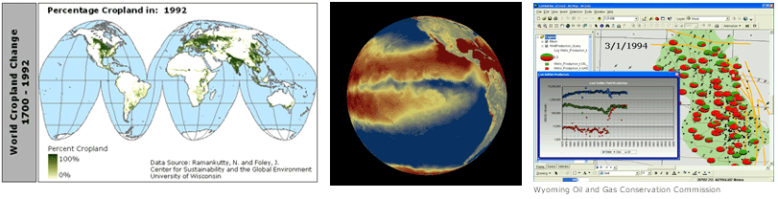
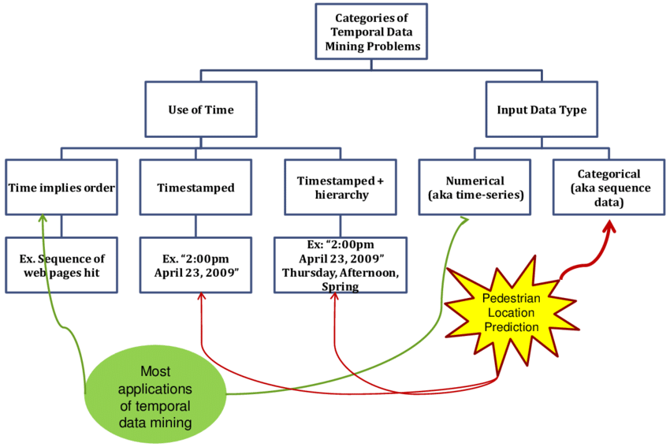
Temporal Data Mining

Slide 14
Temporal Data Mining
import numpy as np
import pandas as pd
import matplotlib.pyplot as plt
from statsmodels.tsa.arima.model import ARIMA
# Generate sample time series data
np.random.seed(0)
time_steps = 100
t = np.arange(time_steps)
data = 2 * np.sin(0.1 * t) + np.random.normal(scale=0.5, size=time_steps)
# Create a pandas DataFrame
df = pd.DataFrame(data, columns=['Value'])
# Fit ARIMA model
model = ARIMA(df['Value'], order=(2, 1, 1))
model_fit = model.fit()
# Forecast future values
forecast_steps = 10
forecast, stderr, conf_int = model_fit.forecast(steps=forecast_steps)
# Plot original data and forecasted values
plt.plot(t, df['Value'], label='Original Data')
plt.plot(t[-1] + np.arange(1, forecast_steps + 1), forecast, label='Forecast')
plt.fill_between(t[-1] + np.arange(1, forecast_steps + 1), forecast - stderr, forecast + stderr, color='gray', alpha=0.2)
plt.xlabel('Time')
plt.ylabel('Value')
plt.title('Time Series Forecasting')
plt.legend()
plt.show()

Slide 15
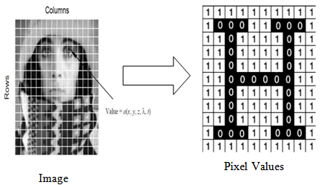
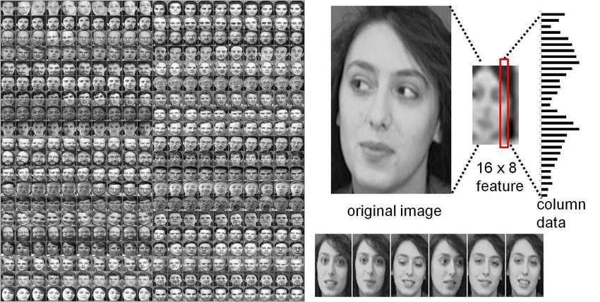
Image processing in Data Mining
Image processing in data mining involves the analysis and manipulation of digital images to extract meaningful information, patterns, and insights. It combines techniques from both data mining and computer vision to process and analyze visual data. Image processing in data mining is commonly used in applications such as image classification, object detection, image segmentation, and more.
Examples of image processing in data mining applications include:
Image Classification: Assigning labels or categories to images based on their content, such as classifying animals in images or identifying handwritten digits.
Object Detection: Locating and identifying specific objects within an image, like detecting faces in photographs or identifying vehicles in satellite imagery.
Image Segmentation: Dividing an image into meaningful regions or segments, which can be useful for medical image analysis, satellite imagery, and more.
Feature Extraction: Extracting relevant features or characteristics from images that can be used for further analysis or modeling.
Image Similarity and Retrieval: Finding similar images in a large dataset based on visual content, which is useful for content-based image retrieval.

Slide 16
Image processing in Data Mining
import numpy as np
import matplotlib.pyplot as plt
from tensorflow import keras
from tensorflow.keras import layers
# Load and preprocess a sample image dataset (e.g., CIFAR-10)
(x_train, y_train), (x_test, y_test) = keras.datasets.cifar10.load_data()
x_train, x_test = x_train / 255.0, x_test / 255.0
# Define a simple convolutional neural network (CNN) model
model = keras.Sequential([
layers.Conv2D(32, (3, 3), activation='relu', input_shape=(32, 32, 3)),
layers.MaxPooling2D((2, 2)),
layers.Conv2D(64, (3, 3), activation='relu'),
layers.MaxPooling2D((2, 2)),
layers.Conv2D(64, (3, 3), activation='relu'),
layers.Flatten(),
layers.Dense(64, activation='relu'),
layers.Dense(10)
])
# Compile the model
model.compile(optimizer='adam',
loss=keras.losses.SparseCategoricalCrossentropy(from_logits=True),
metrics=['accuracy'])
# Train the model
history = model.fit(x_train, y_train, epochs=10, validation_data=(x_test, y_test))
# Plot training and validation accuracy over epochs
plt.plot(history.history['accuracy'], label='Training Accuracy')
plt.plot(history.history['val_accuracy'], label='Validation Accuracy')
plt.xlabel('Epoch')
plt.ylabel('Accuracy')
plt.legend()
plt.show()

Slide 17
Practice Resources in Data Mining
Image Processing:
https://www.kaggle.com/code/akshayt19nayak/getting-started-image-processing-basics
https://www.kaggle.com/code/gauravduttakiit/image-processing-notebook
Text Mining:
https://www.kaggle.com/code/kanncaa1/applying-text-mining/notebook
Web Mining: (1) https://www.kaggle.com/code/adoury/web-mining-project-web-mining-analysis
(2) https://www.kaggle.com/code/benboyet/web-mining-project-text-mining-part

